Slide 1

DATA QUEST – Unlocking the
Power of Data
Case Study Challenge 2023
Statistics Track – Preliminary Round
From fork to fitness!
Exploring the Relationship Between Eating Patterns and Obesity
Notes:
Title slide
Front page
First page
Life-changing careers
China

Slide 2
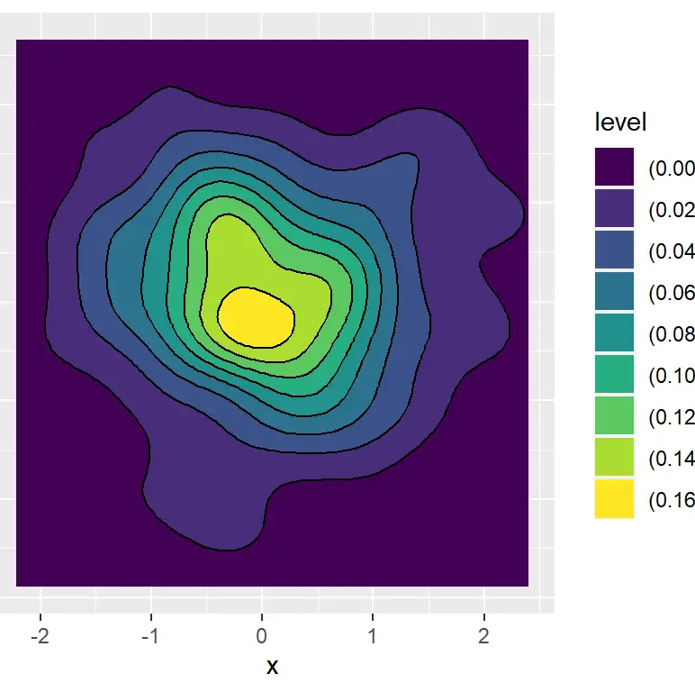
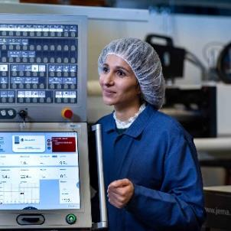


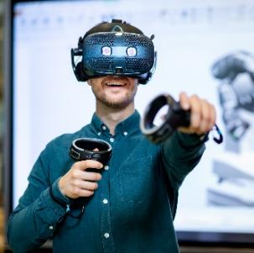
The magic pill for teens with obesity – Testa!
Background
Your team is heading the core Statistics team of XYZ Pharmaceuticals that primarily deals with obesity therapeutic area. After years of research, the drug development team has created the formulation of the magical drug, "Testa" which aims to reduce obesity in teens. Is Testa clinically effective in combating obesity in teens?
02.
Data Description
01.
Population 250 young teens with obesity are administered treatments A & B randomly.
03.
Analysis and Recommendation
Challenge
Which of the two treatments is your magic Pill – Testa in reducing body weight?
How TestQ scores better explain eating behavior patterns?
Pitch in your insights and recommendations.
We encourage you to explore, visualize and dig in any hidden patterns/anomalies in the data
Clinical Outcome BMI, Body Weight.
b) Demographics
Age, Race, Country, …… Median Income, Gender
c) Eating behaviour Questionnaire
TestQ
Three factor Questionnaire
Emotional Eating Score (ECS)
Uncontrolled Eating Score (UCS)
Unrestrained Control Score (RCS)
Note: The details of all the variables in the dataset is available in the Slide 3.
Notes:
Process
Looped process
3 steps
P&O
Life-changing careers
People and organization

Slide 3
Variable Description
Variable | Description
ID 1:250 | The unique ID assigned to each teen that is enrolled and eligible for the trial. There are 250 study participants.
Treatment “A”, “B” | Each of the 250 study participants are randomly assigned to “A” or “B” such that there are 125 subjects in each treatment group.
Gender “Male”, “Female” | Out of the 250 study participants, 125 are males and 125 are females.
Visit “0” – Baseline visit (Week 0) , “1” – Week 13, “2” – Week 26, “3” – Week 52 (End of Treatment visit) | The visits at which the clinical outcome measurements and self-reported questionnaire scores are collected. The participants will have to fill in three scores of TestQ questionnaire at each of the visits.
Age (in years) | Collected only at Visit 0 – Baseline.
BMI (in kg/m^2) | The clinical outcome collected at each of the four visits.
Weight (in kg) | The clinical outcome collected at each of the four visits.
Race “CAUCASIAN”, “HISPANIC”, “ASIAN”, “LATIN AMERICAN”, “AFRICAN” | Represents the Race of the study participant.
Country “China”, “México”, “USA”, “Cook Islands”, “Brazil” | Represents the Nationality of the study teen.
UCS – Uncontrolled Eating Score | A component of TestQ that assesses the tendency to eat in response to negative emotions. UCS ranges from 1-20. Higher the score, greater is the risk of obesity.
ECS – Emotional Eating Score | A component of TestQ that assesses the tendency to overeat, with the feeling of being out of control. ECS ranges from 1-20. Higher the score, greater is the risk of obesity.
RCS – Unrestrained Control Score MedIncome | A component of TestQ that assesses tendency to not being able to restrict one’s food intake constantly and consciously. RCS ranges from 1-20. Higher the score, greater is the risk of obesity. Represents the average annual median income of the family where the teen belongs to,

Slide 4
General Instructions
Submission Guidelines:
Use the slide template “Stat_Prelim_Response” provided for your submission.
You are allowed to use a maximum of 3 visualizations + 2 tables. You are encouraged to approach the problem statement from multiple dimensions with proper reasoning/justification.
A maximum of 8 slides can be used for your content leaving aside the Intro slides.
In case of any queries pertaining to the challenge, kindly reach out to ebth@novonordisk.com
The submission deadline is 10th July 2023. Submit your entry via email to gvch@novonordisk.com
Evaluation Criteria:
Use of appropriate statistical methodology with reasoning.
Unlocking the solutions from multiple perspectives.
Recommendations/Actions based on the results.
Presentation content and adherence to the time/slide limit.

